Slide 1
Sloveso to BE

Slide 2
Z Zopakujme si sloveso to be- BYŤ
Singular-jednotné číslo
I am Ja som
You are Ty si
She is Ona je
He is On je
It is Ono je
Plural-množné číslo
We are My sme
You are Vy ste
They are Oni sú

Slide 3
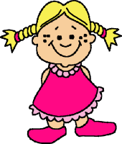
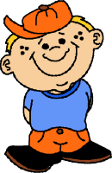
Skrátená forma slovesa to be-byť
dlhá forma
long form
krátkaforma
short form
I am ---- I’m
You are ---- You’re
She is ---- She’s
He is ---- He’s
It is ---- It’s
We are ---- We’re
You are ---- You’ re
They are ---- They’re

Slide 4
TO BE – negative-Zápor
long forms
I am not ja nie som
you are not ty nie si
he is not on nie je
she is not ona nie je
it is not ono nie je
short forms
I´m not
you aren´t
he isn´t
she isn´t
it isn´t

Slide 5
TO BE - negative
long forms
we are not my nie sme
you are not vy nie ste
they are not oni,ony nie sú
we aren´t
you aren´t
they aren´t
short forms

Slide 6
Precvičme si:
https://www.youtube.com/watch?v=ZimezwjN6Mk
Make the sentences negative.Utvor zápornú vetu:
I am from France.
I am not from France.
You’re my friends.
You’re not my friends.
They are from London.
They are not from London.

Slide 7
Thank you

