Slide 1
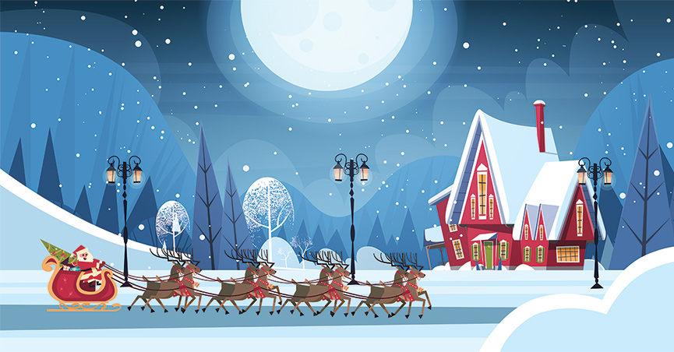
Christmas in English countries
traditions, customs, dishes
Szymon Mazur, klasa IV

Slide 2
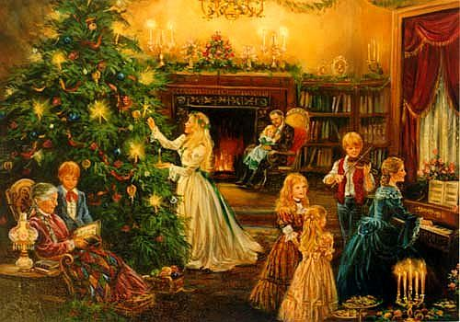
Christmas Tree
It first appeared in Great Britain in the 19th century and this tradition was initiated by Queen Charlotte, who was a German and wife of George III.

Slide 3
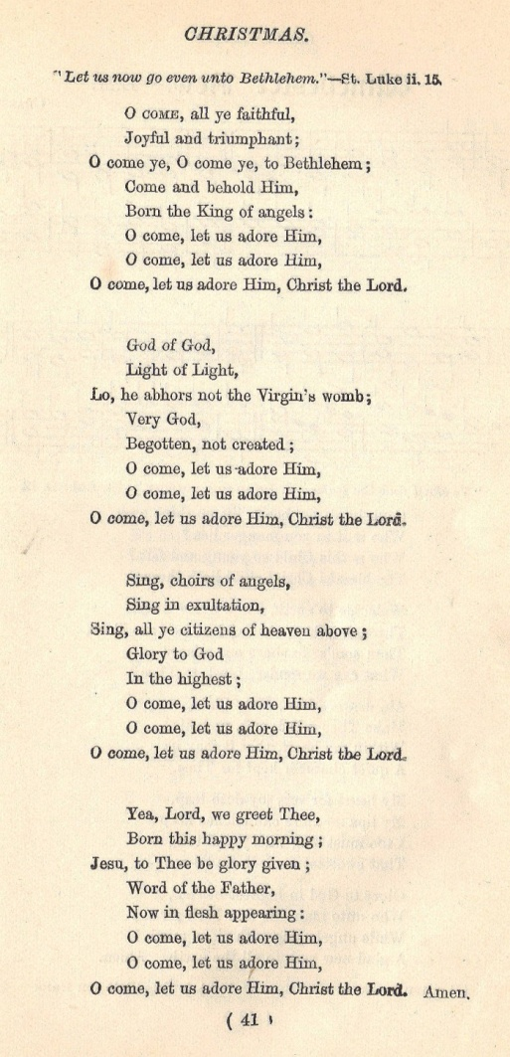
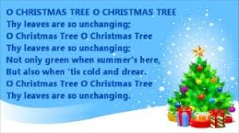
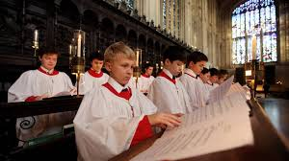
Christmas Carols
Christmas carols are special songs which are sung during the Christmas season. The songs are about Jesus and the time when he was born.
Christmas Carols and when they were composed:
1843 - O Come all ye Faithful
1848 - Once in Royal David's City
1851 - See Amid the Winters Snow
1868 - O Little Town of Bethlehem
1883 - Away in a Manger

Slide 4
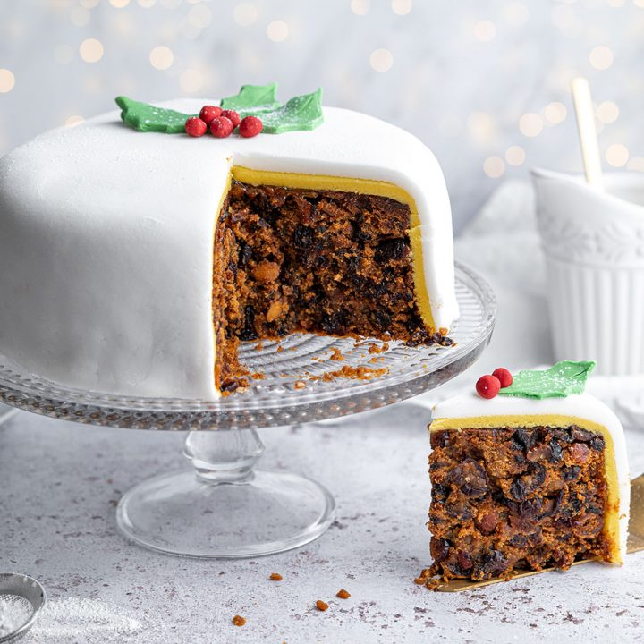
Christmas Cake
It is a type of cake,
often fruit cake,
served at Christmas time.

Slide 5
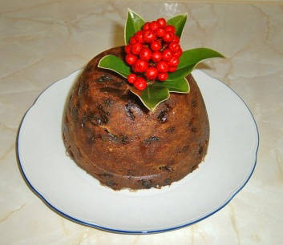
Christmas pudding
It is a type of pudding traditionally served as part of the Christmas dinner in the UK,Ireland and in other countries where it has been brought by British and Irish immigrants.

Slide 6
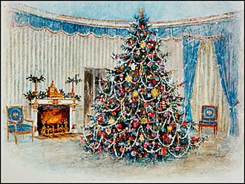
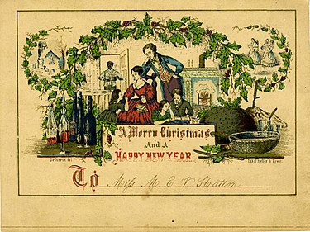
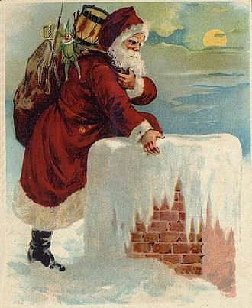
Christmas Card
It is a greeting card sent as part of the traditional celebration of Christmas.
The traditional greeting reads „Wishing you a Merry Christmas and a Happy New Year".

Slide 7
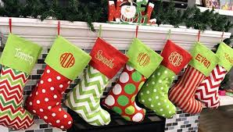
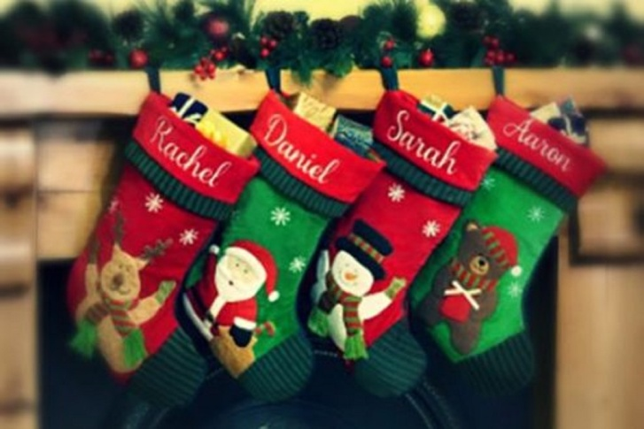
Christmas Stocking
It is an empty sock or sock-shaped bag that Santa Claus can fill it with small toys, candy, fruit, coins or other small gifts when he arrives.
The tradition of the Christmas stocking is thought to originate from the life of Santa Claus.

Slide 8
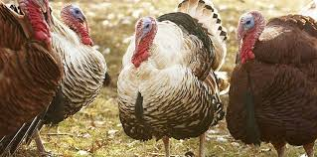
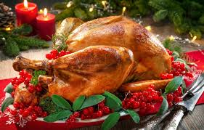
Turkey
King Henry VIII was the first person to eat a turkey on Christmas Day, however after the 1950 the turkey was more popular Christmas meal choice than the goose.

Slide 9
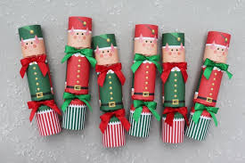
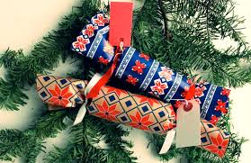
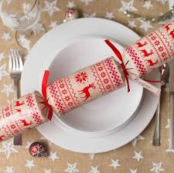
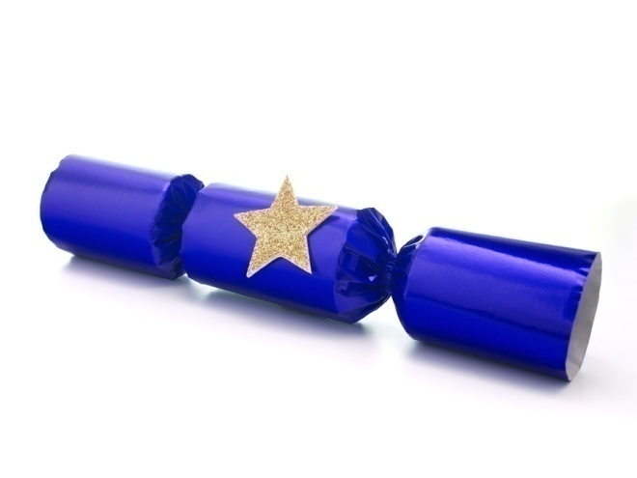
Christmas Cracker
It is a tube of brightly coloured paper, given at Christmas that
makes a noise when pulled apart by two people and contains small present.

Slide 10
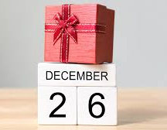
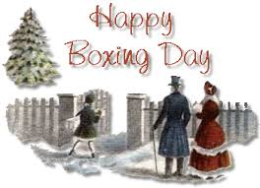
Boxing Day
It is the second day of Christmas
on 26th of December.
Why it is call „Boxing day”?
One of theory is that churches put out boxes for people to give money to the poor, and the money was distributed the day after Christmas.

Slide 11
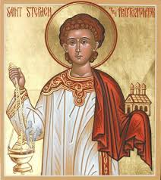
St. Stephen's Day
It is a Christian saints day to commemorate Saint Stephen, the first Christian martyr, celebrated on 26 December.
Very popular in Ireland.

Slide 12
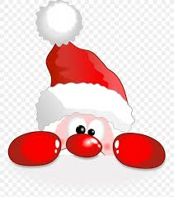
Christmas Quiz
1. What color is Rudolph’s nose?
Blue b. Red c. Brown
2. Where does Santa Claus live?
a. The North Pole b. The beach c. On the moon
3. Who helps Santa Claus make toys?
a. Reindeer b. Angels c. Elves
4. True or False: Most kids set out chips and dip for Santa Claus on Christmas Eve.
5. What color are Santa’s boots?
Red b. Black c. Green

Slide 13
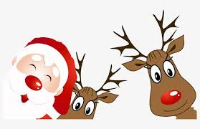
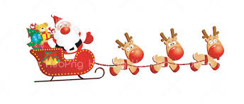
Christmas Quiz
6. How many times does Santa Claus check his list?
a. Three times b. Five times c. Twice
7. True or False: Elves are tall.
8. What does Santa Claus bring on Christmas Eve to children who are naughty?
a. Coal b. Underwear c. A stick
9. Which of the following is one of Santa’s reindeer?
a. Jingle b. Comet c. Sleepy
10. Where does Santa Claus usually leave presents when he visits a home?
a. In the front yard b. On the roof c. Under the Christmas tree

Slide 14
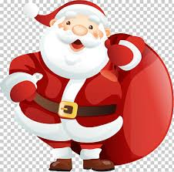
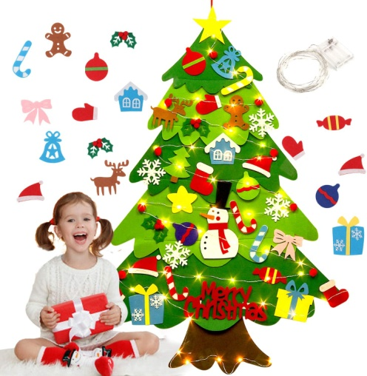
Christmas Quiz
11. True or false: Santa Claus is married.
12. Which of the following decorations do NOT go on a Christmas tree?
a. Lights b. Tinsel c. Balloons
13. What do Santa’s reindeer pull on Christmas Eve?
a. A sleigh full of presents b. A car c. An airplane
14. What two colors do people decorate with at Christmas the most?
a. Black and orange b. Pink and purple c. Red and green
15. What flavor are candy canes?
a. Peppermint b. Macaroni and cheese c. Pizza

Slide 15
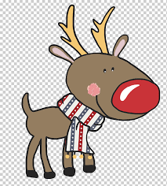
Christmas Quiz
16. What is hung on the fireplace at Christmastime?
a. Pants b. Stockings c. Hair ribbons
17. True or False: The Grinch is blue.
18. Whose birthday is celebrated on Christmas Day?
a. The president b. Jesus c. Santa Claus
19. Who told Mary she was going to have a baby?
a. A doctor b. An angel c. Her mother
20. What animal carries Mary to Bethlehem?
A horse b. A camel c. A donkey
21. Where was the baby Jesus born?
a. A stable b. A hospital c. The North Pole

Slide 16
Christmas Quiz - answers
Christmas Quiz for Children Answers
1. What color is Rudolph’s nose? Red
2. Where does Santa Claus live? The North Pole
3. Who helps Santa Claus make toys? Elves
4. True or False: Most kids set out chips and dip for Santa Claus on Christmas
Eve. False – Most children set out cookies and milk for Santa Claus.
5. What color are Santa’s boots? Black
6. How many times does Santa Claus check his list? Twice
7. True or False: Elves are tall. False – Most elves are short.
8. What does Santa Claus bring on Christmas Eve to children who are
naughty? Coal
9. Which of the following is one of Santa’s reindeer? Comet
10. Where does Santa Claus usually leave presents when he visits a home?
Under the Christmas tree
11. True or false: Santa Claus is married. True
12. Which of the following decorations do NOT go on a Christmas tree?
Balloons
13. What do Santa’s reindeer pull on Christmas Eve? A sleigh full of presents
14. What two colors are popular at Christmas? Red and green
15. What flavor are candy canes? Peppermint
16. What is hung on the fireplace at Christmastime? Stockings
17. True or False: The Grinch is blue. False – The Grinch is green.
18. Whose birthday is celebrated on Christmas Day? Jesus
19. Who told Mary she was going to have a baby? An angel
20. What animal carries Mary to Bethlehem? A donkey
21. Where was the baby Jesus born? A stable

